Slide 1
Phase 1 Presentation – Environment Setup & Lab Preparation
By
Devarshi Mahadevwala
Mentor:
Ahmad Ghobeiti

Slide 2
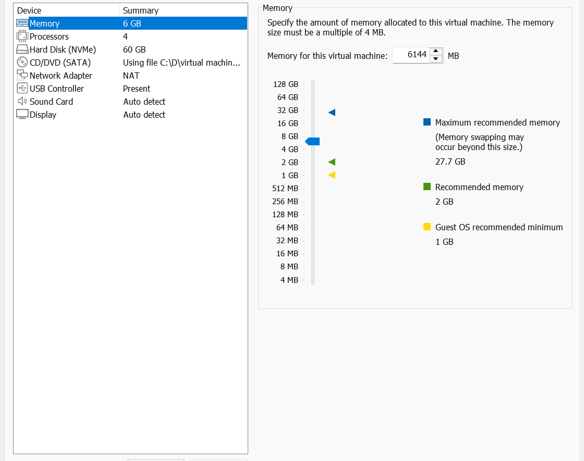
Objective of Phase 1
Build a controlled forensic lab in VMware
Prepare Windows (victim) & Kali (attacker/forensics)
Install all required tools
Configure and isolate the network
Validate connectivity & capture clean VM snapshots

Slide 3
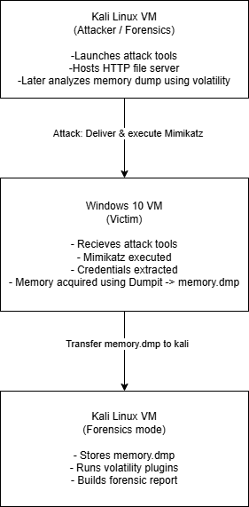
Architecture and Flow
Two-Machine Forensic Lab
Kali Linux → attacker + forensic workstation
Windows 10 → victim endpoint
Communication over Host-Only 192.168.72.0/24
No internet access = safe & isolated

Slide 4
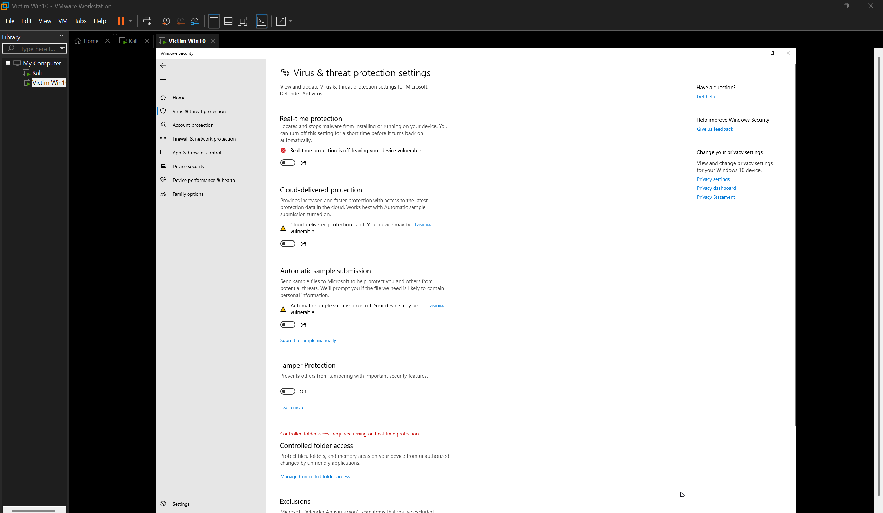
Windows Victim Configuration
Preparation Performed
Disabled Windows Defender protections
Disabled Firewall (lab-safe only)
Created working folder C:\Tools
Extracted Sysinternals, Mimikatz, DumpIt

Slide 5
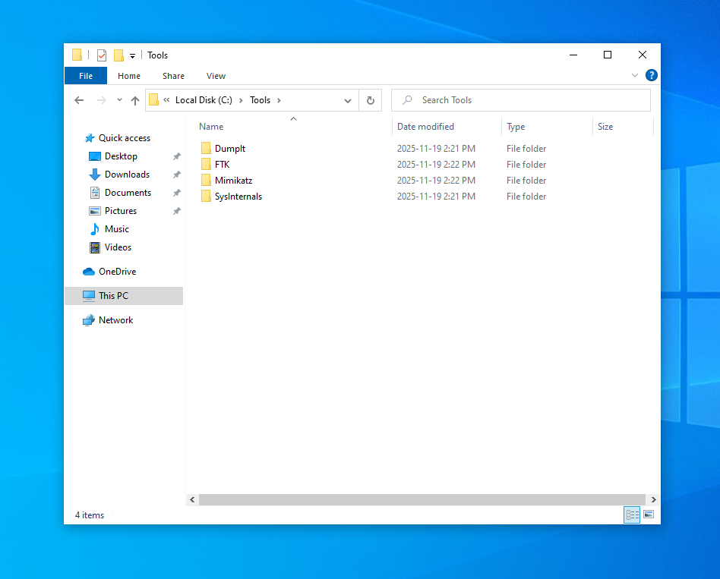
Windows Tools Installation
Purpose
Memory acquisition: DumpIt
System monitoring: Sysinternals
Credential theft simulation: Mimikatz

Slide 6
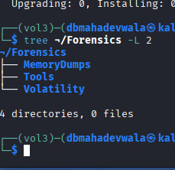
Kali Linux Setup
Kali Roles
Host Mimikatz payload via Python server
Perform forensic analysis (Volatility 3)
Configured:
System updated
Installed curl, wget, net-tools, unzip
Created AttackTools & Forensics directories

Slide 7
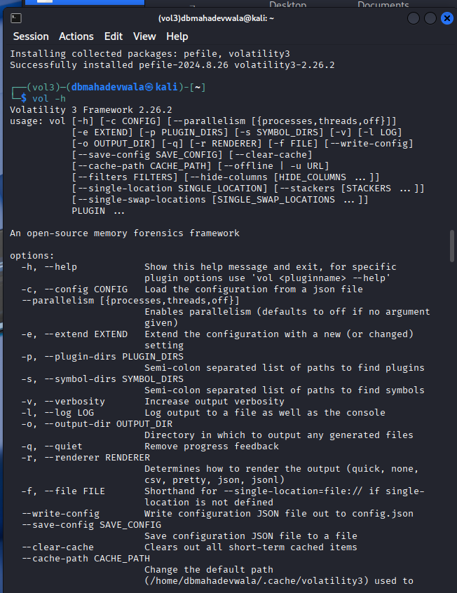
Volatility 3 Installation
Why Volatility 3?
Modern memory forensics framework
Works directly with Windows DumpIt .dmp image
Used in Phase 3 to extract credentials, processes, network artefacts

Slide 8
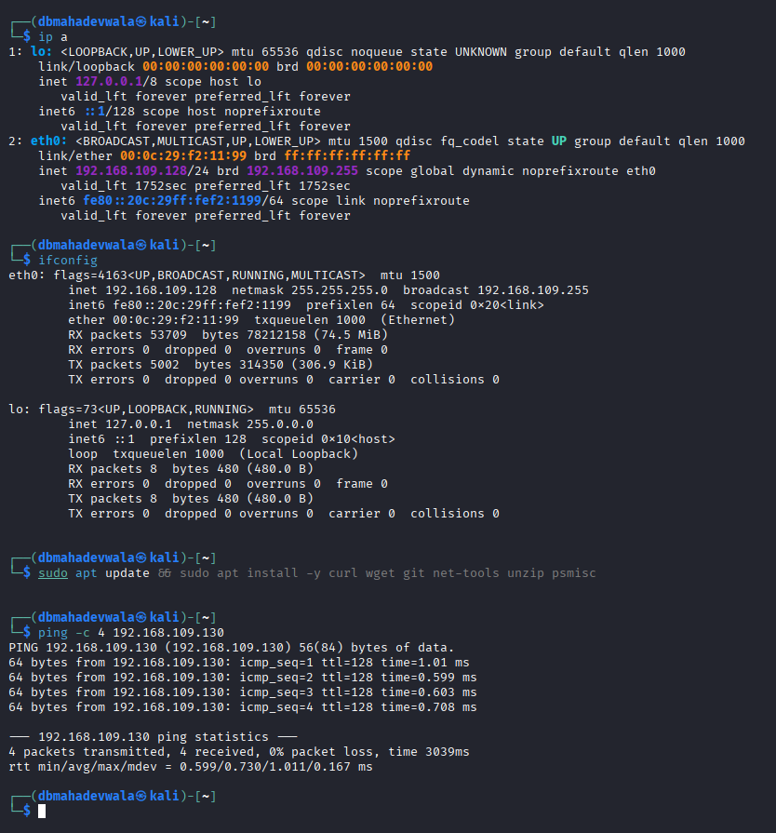
NAT Connectivity Test
Purpose
Ensure both VMs can reach each other
Verify ability to download tools before isolation

Slide 9
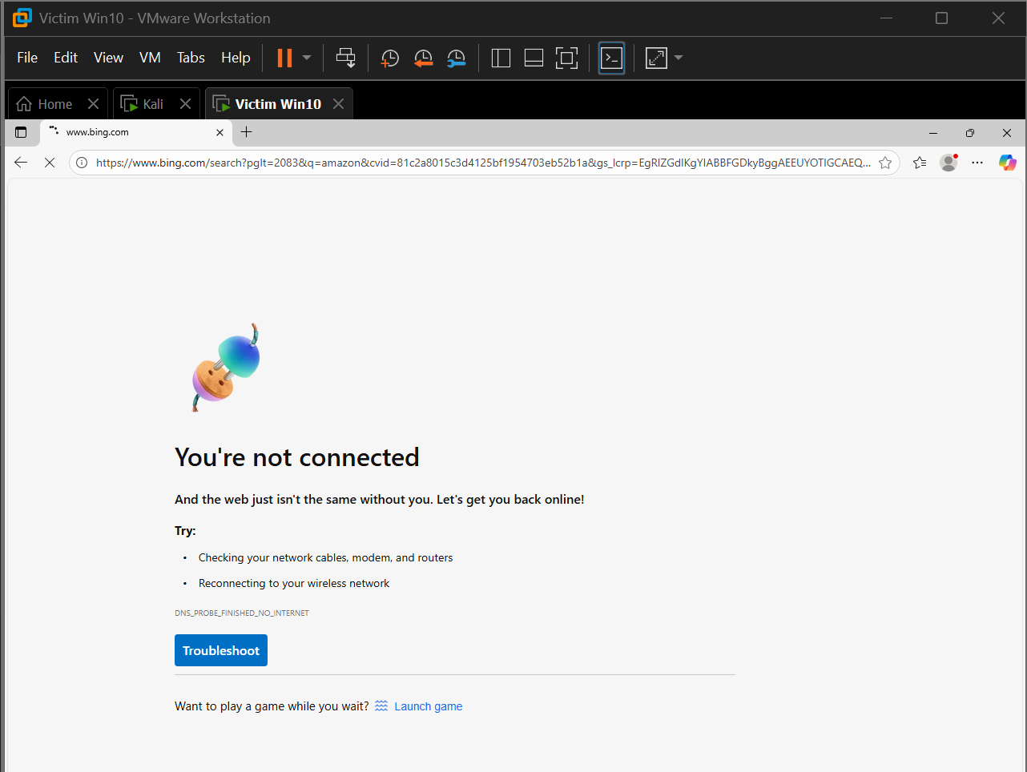
Host-Only Isolation Setup
After Tool Installation
Switched VMs to Host-Only Network
Machines communicate only internally
Internet intentionally blocked for safety

Slide 10
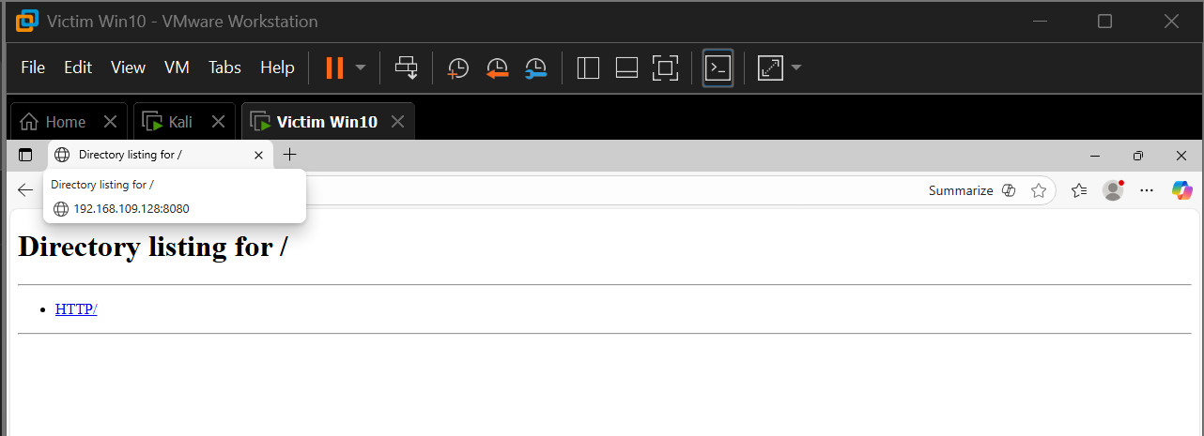
Internal File Transfer Test
Goal
Verify payload delivery method for Phase 2
Used Python HTTP server on Kali
Windows successfully accessed Kali server

Slide 11
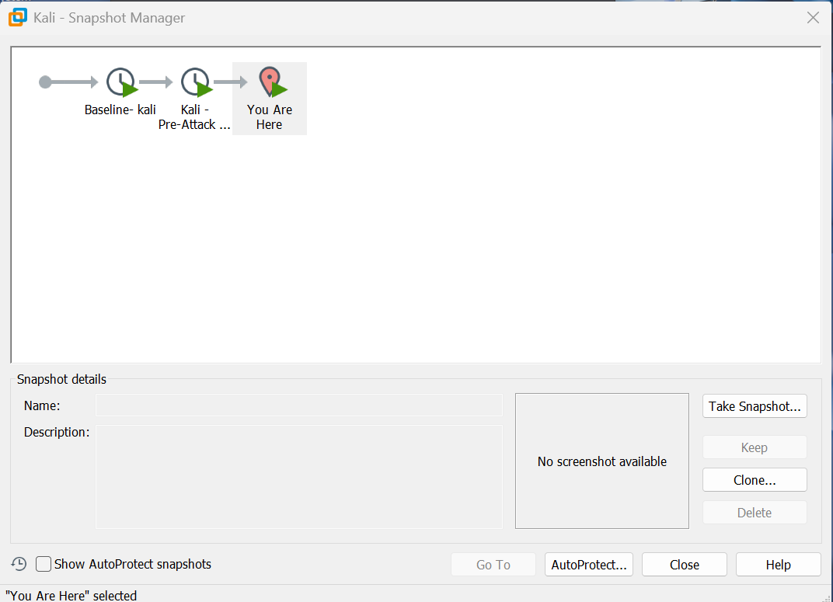
Snapshot Creation
Purpose
Ensures clean rollback
Guarantees reproducible attack & forensics
Required for safe incident simulation

Slide 12
Phase 1 Summary
Completed in Phase 1
Built isolated VMware forensic lab
Prepared Windows victim with tools & settings
Prepared Kali attacker + forensic machine
Installed Volatility 3, Sysinternals, DumpIt, Mimikatz
Verified connectivity + isolation
Took clean snapshots

